Slide 1
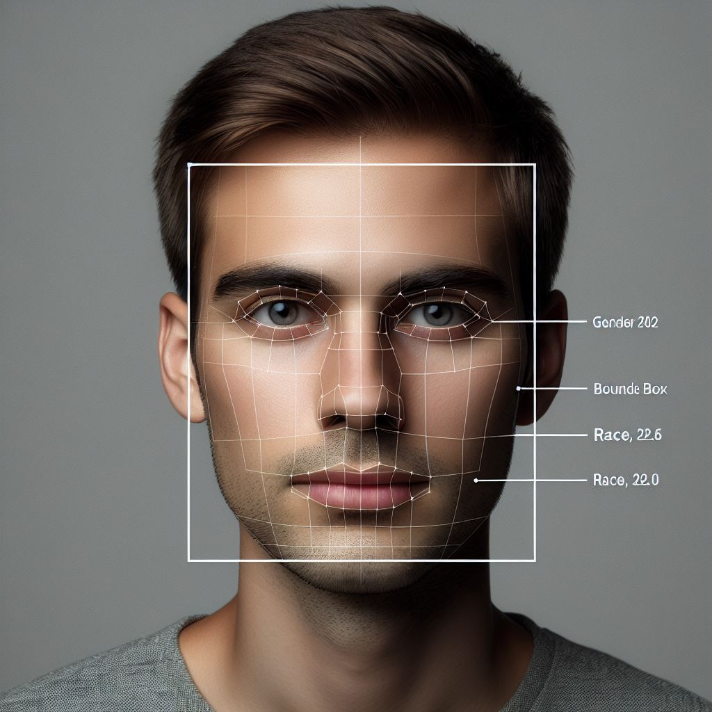
Enhanced ATM Security: Facial Analysis for Profile Monitoring and Alerting
Prepared by Pius Yee (DSI-SG-42)

Slide 2
Introduction
Automated Teller Machines (ATMs) have become an essential part of our daily lives
However, our reliance on physical cards and PINs exposes them to theft, such as ATM skimming, which compromises card information and PINs for fraudulent withdrawals.
ATM skimming is a type of payment card fraud. It’s a way of stealing PINs and other information off credit cards and debit cards by rigging machines with hidden recording devices.

Slide 3
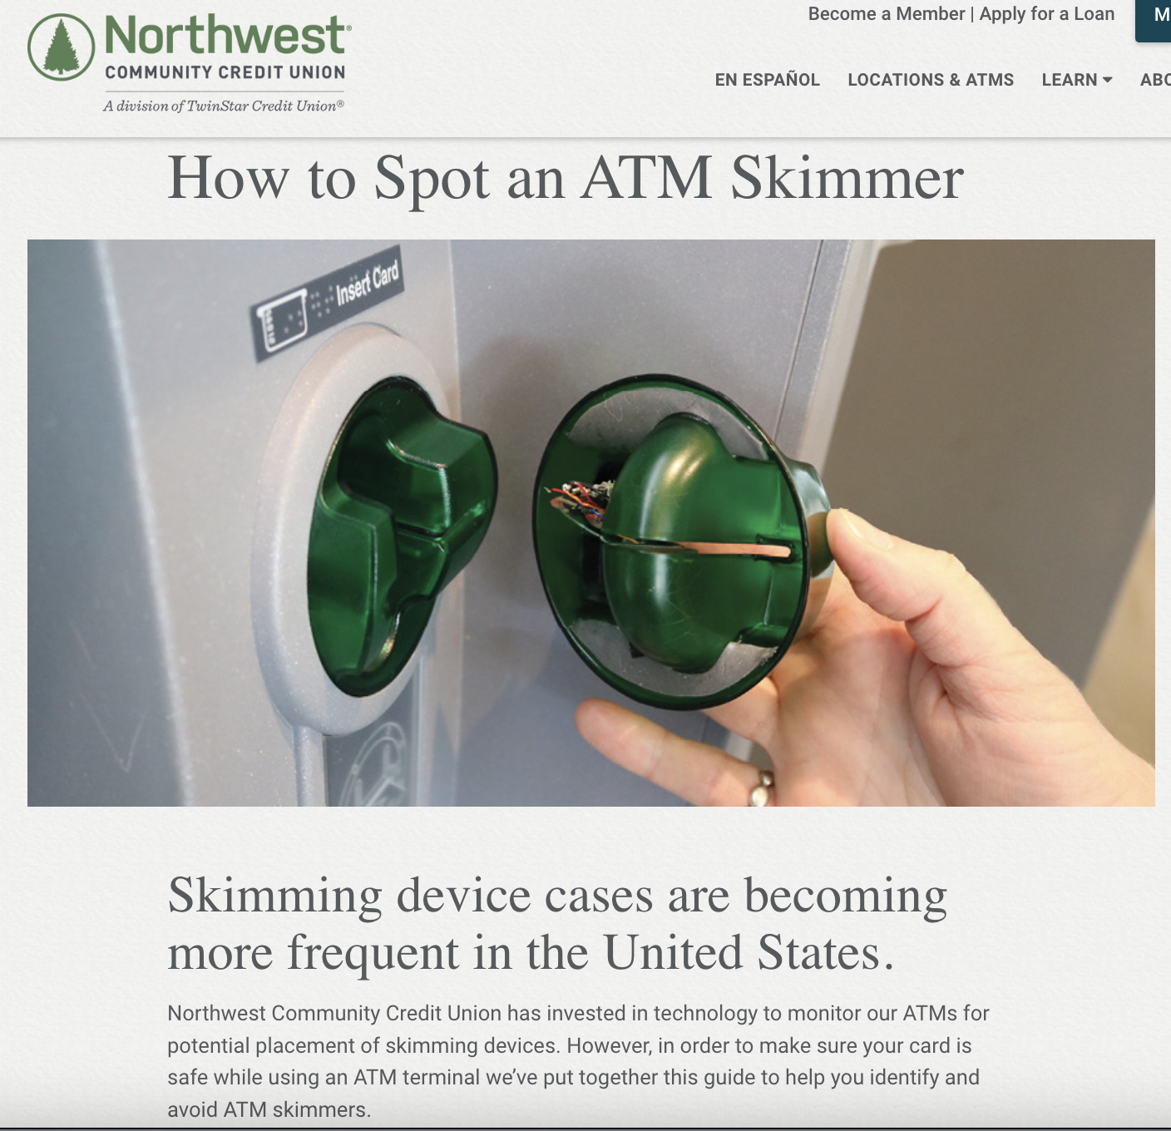
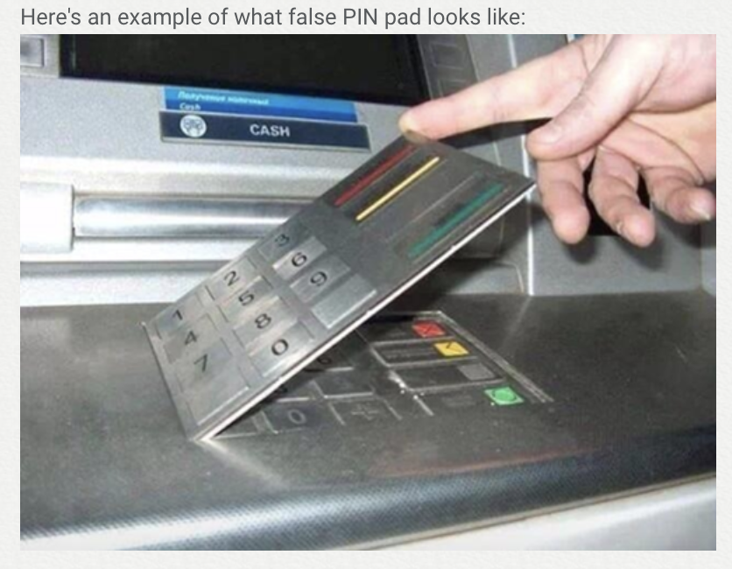
Source: https://www.nwcu.com/learn/how-spot-atm-skimmer

Slide 4
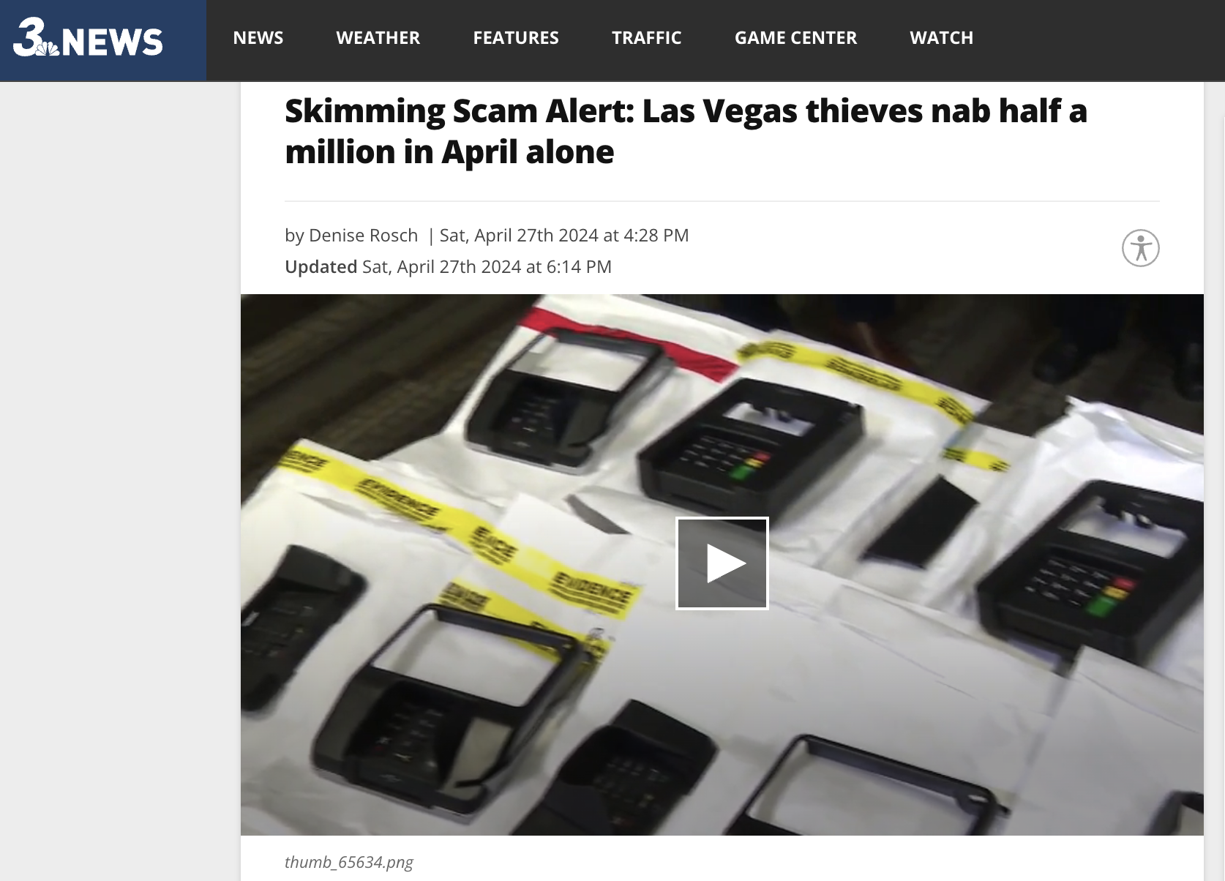
Source: https://news3lv.com/news/local/skimming-scam-alert-las-vegas-thieves-nab-half-a-million-in-april-alone

Slide 5

Persona
Sarah relies on ATMs for quick cash access but expects a secure and efficient experience. With the rise of ATM-related scams, she worries that using an ATM might expose her card details or PIN. She feels particularly unsafe when using ATMs in isolated locations, where the risk of skimming might be higher.

Slide 6
Problem Statement
Existing security measures might not be sufficient to identify and prevent fraudulent withdrawal. Therefore, we need a system that leverages existing ATM infrastructure to introduce an additional layer of security.
How can we utilize profiling using computer vision to provide additional security for bank customers?

Slide 7
How does it work?
Analyze video footage captured by ATM cameras
1
Detect the age, gender, and race of the ATM user
2
Compare with the cardholder’s profile
3
Identify discrepancies that might be suspicious
4
Trigger real-time alerts to the cardholder or bank
5
Notes:
Current situation vs my proposed idea

Slide 8
Machine learning models
Face Detection model
Gender classification model
Race classification model
Age classification model
8
Notes:
classification

Slide 9
Data collection and pre-processing

Slide 10
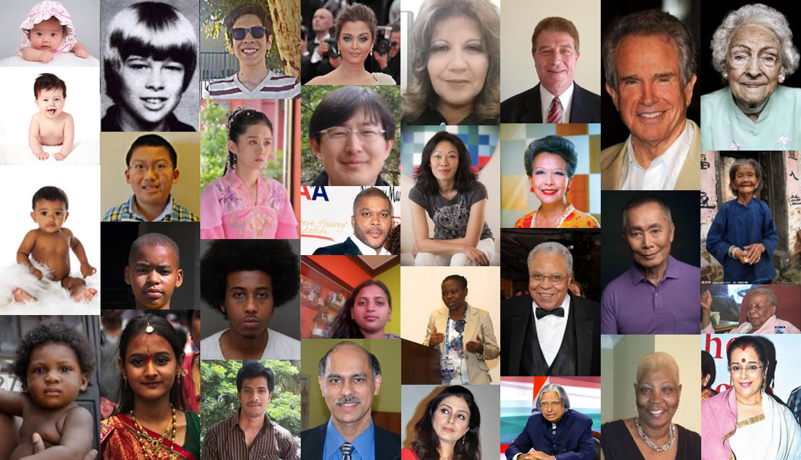
Dataset used
UTKFace
The raw data utilized for this project is the UTKFace dataset.
It is a large-scale face dataset encompassing a wide age range, from 0 to 116 years old.
The dataset comprises over 23,000 face images annotated with
Gender
Race
Age

Slide 11
Augmentation on training datasets
Augmentation types | Value | Description
Width shift | 20% | Randomly shifts the image horizontally along the width by up to 20% of the total width, enhancing model robustness to object position variations.
Height shift | 20% | Randomly shifts the image vertically along the height by up to 20% of the total height, similar to the width shift but in the vertical direction.
Shear | 20% | Applies a shear transformation, slanting the image along one axis, helping simulate perspective changes.
Zoom | 20% | Randomly zooms the image in or out by up to 20%, making the model more resilient to changes in the object's apparent size.
Horizontal flip | NA | Randomly flips the image horizontally (like looking in a mirror), helping prevent the model from developing biases based on left/right orientation.

Slide 12


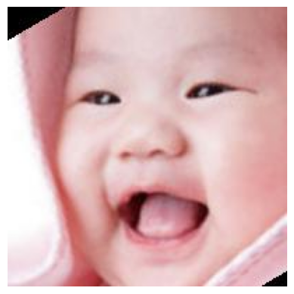


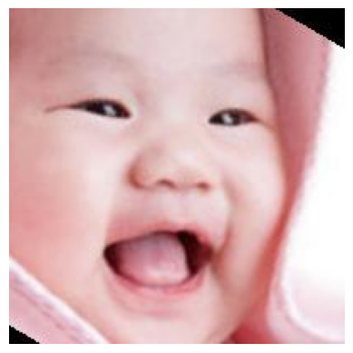
Augmentation on training datasets
Original
Width shift
Horizontal flip
Height shift
Zoom
Shear

Slide 13
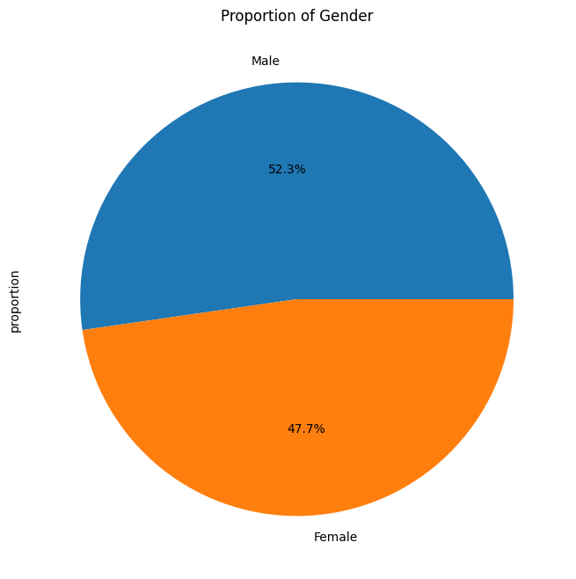
Gender
The proportion of Male and female is balanced

Slide 14
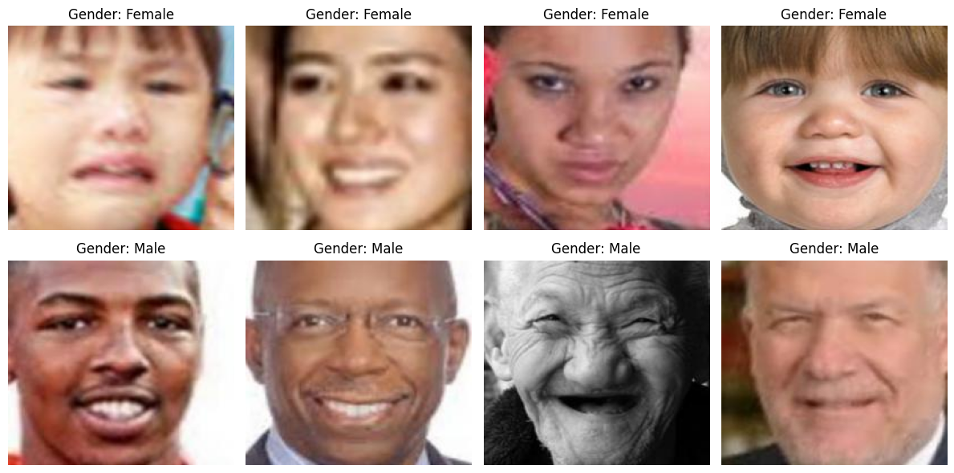
Gender
Some examples of Male and Female datasets:

Slide 15
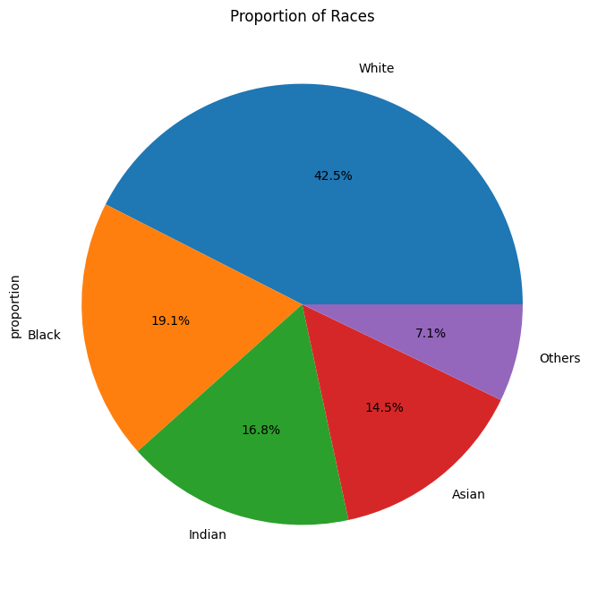
Race
White has the highest proportion in the dataset, followed by Black, Indian, Asian and Others.

Slide 16
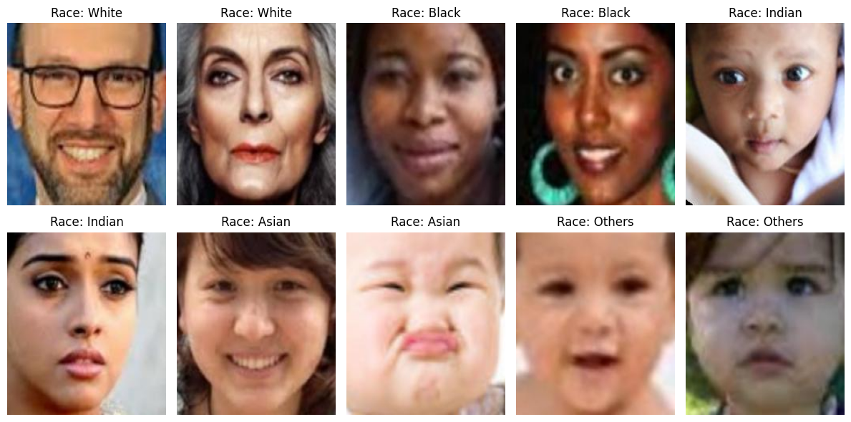
Race
Some examples of racial datasets:

Slide 17
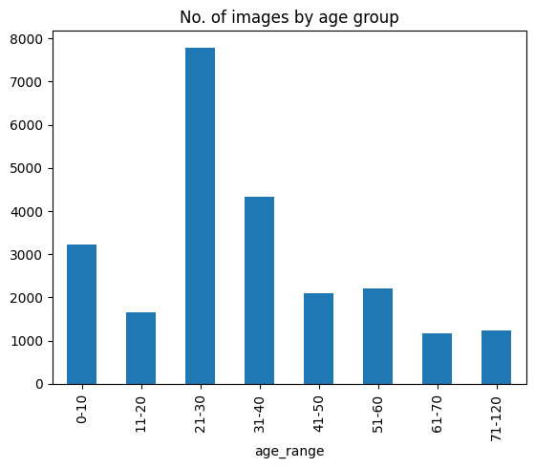
Age
Age group ‘21-30’ has the highest proportion

Slide 18
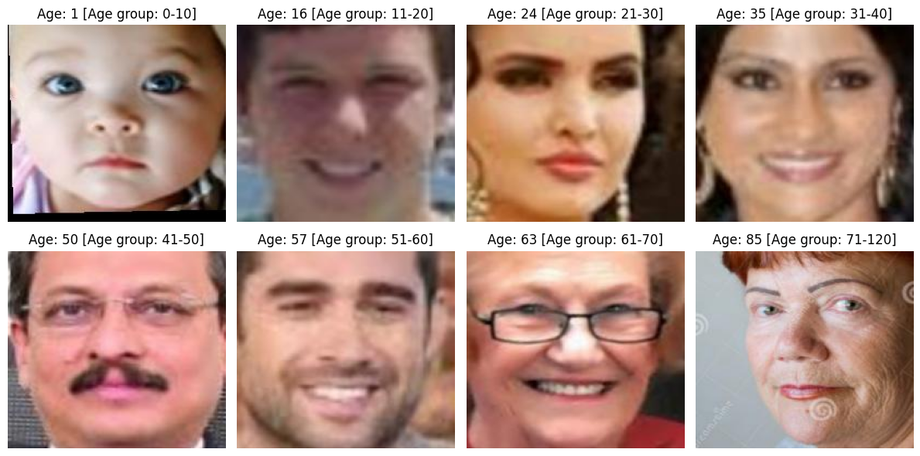
Age
Some examples of age datasets:

Slide 19
Modelling

Slide 20
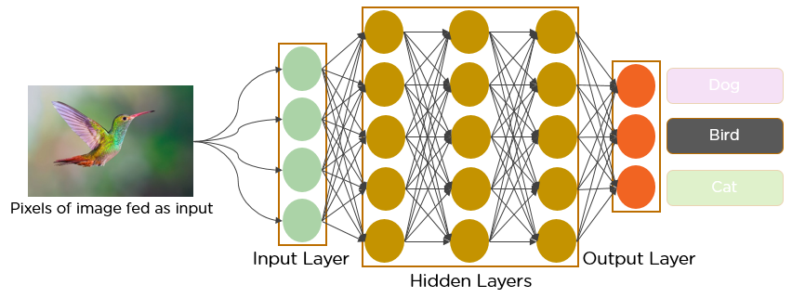
CNN (Convolutional Neural Networks)
Neural networks are like our brains, learning to find patterns in data.
CNNs are special neural networks that excel at analyzing images. Think of them as image detectives with special magnifying glasses that look for shapes, colors, and patterns.
Image from: https://www.analyticsvidhya.com/blog/2021/05/convolutional-neural-networks-cnn/
20

Slide 21
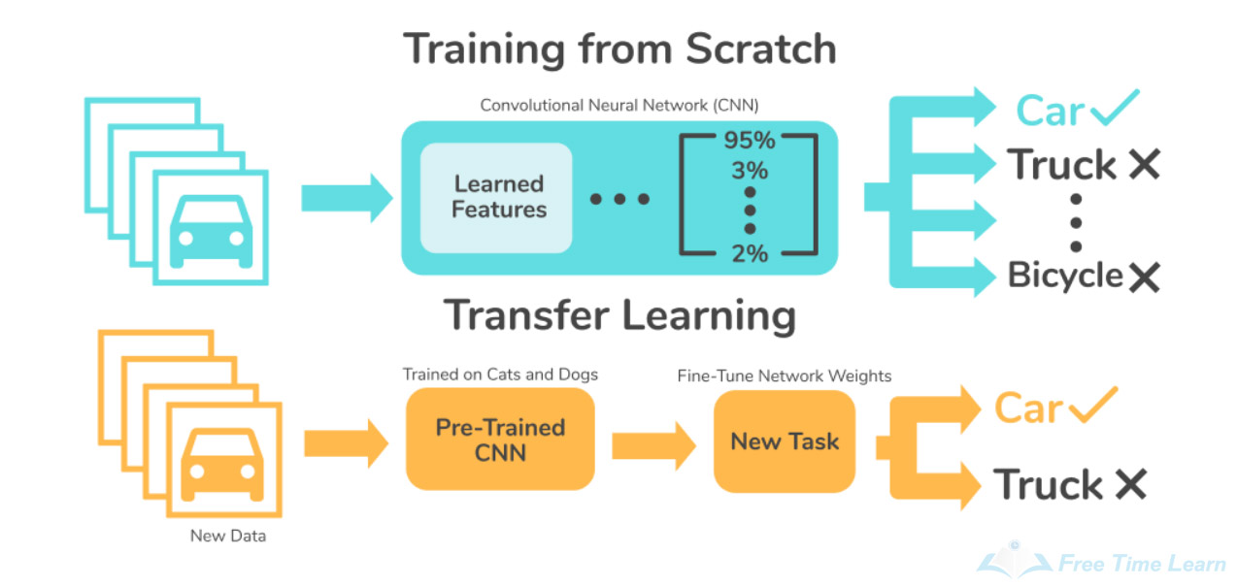
Transfer learning of pre-trained model
Neural networks are like our brains, learning to find patterns in data.
CNNs are special neural networks that excel at analyzing images. Think of them as image detectives with special magnifying glasses that look for shapes, colors, and patterns.
Image from: https://skyengine.ai/se/skyengine-blog/128-what-is-transfer-learning
21

Slide 22
Machine learning models
Face Detection model
Gender classification model
Race classification model
Age classification model
22
Notes:
classification

Slide 23
Machine learning models
Face Detection model
Gender classification model
Race classification model
Age classification model
23
Notes:
classification

Slide 24

Gender Classification model

Slide 25
Modelling process
Gender
The best base model
CNN (Convolutional Neural Network)
Output
Hyperparameter tuning
Base models
VGGFace
(Pre-trained)
ResNet
(Pre-trained)
25

Slide 26
Base models
Model | Train Accuracy | Test Accuracy
CNN | 0.7356 | 0.7687
VGGFace | 0.9132 | 0.9264
ResNet 50 | 0.5233 | 0.5294

Slide 27
Base models
VGGFace is the best!
Model | Train Accuracy | Test Accuracy
CNN | 0.7356 | 0.7687
VGGFace | 0.9132 | 0.9264
ResNet 50 | 0.5233 | 0.5294

Slide 28
Modelling process
Gender
The best base model
CNN (Convolutional Neural Network)
Output
Hyperparameter tuning
Base models
VGGFace
(Pre-trained)
ResNet
(Pre-trained)
✅
28

Slide 29
Fine Tuning – VGG Face
Early stopping
Batch Normalization
Dropout
Model after fine-tuning

Slide 30
Model Comparison
Model | Train Accuracy | Test Accuracy
CNN | 0.7356 | 0.7687
VGGFace | 0.9132 | 0.9264
ResNet 50 | 0.5233 | 0.5294
VGGFace (tuned) | 0.9110 | 0.9321

Slide 31
Model Comparison
Model | Train Accuracy | Test Accuracy
CNN | 0.7356 | 0.7687
VGGFace | 0.9132 | 0.9264
ResNet 50 | 0.5233 | 0.5294
VGGFace (tuned) | 0.9110 | 0.9321

Slide 32
Other metrics – VGGFace (fine-tuned)
Accuracy
0.93
Precision
0.93
Recall
0.93
F1 score
0.93

Slide 33
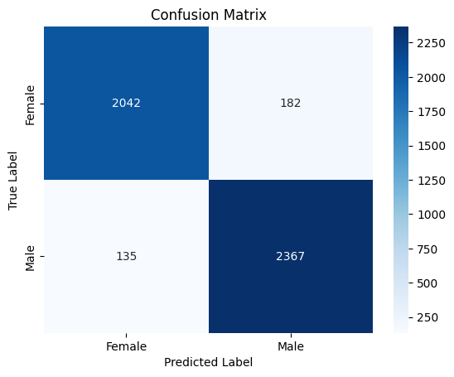
Confusion Matrix

Slide 34
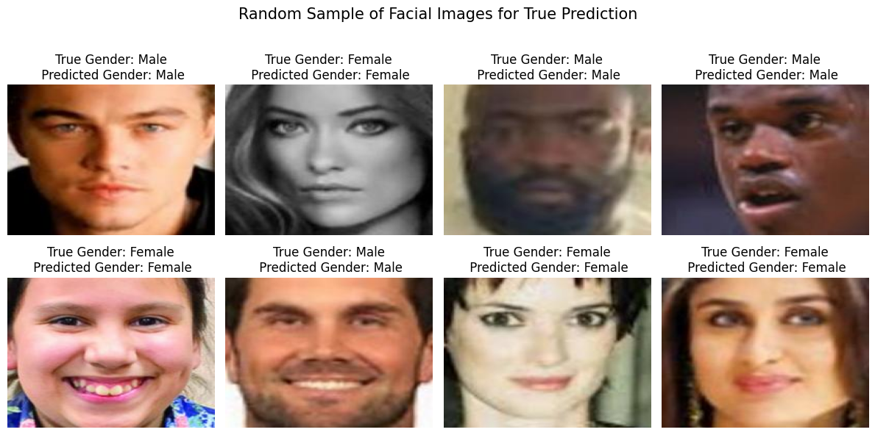
Samples of True Prediction

Slide 35
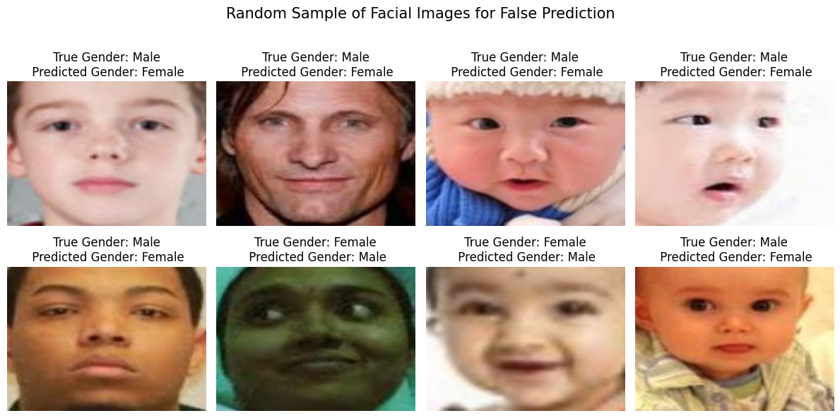
Samples of False Prediction

Slide 36
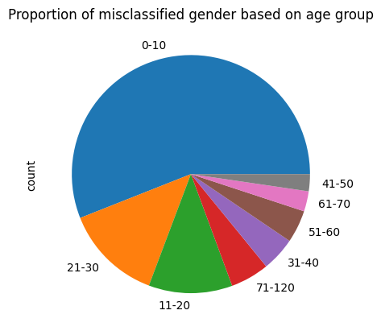
Proportion of misclassified gender based on age group

Slide 37
Machine learning models
Face Detection model
Gender classification model
Race classification model
Age classification model
37
Notes:
classification

Slide 38
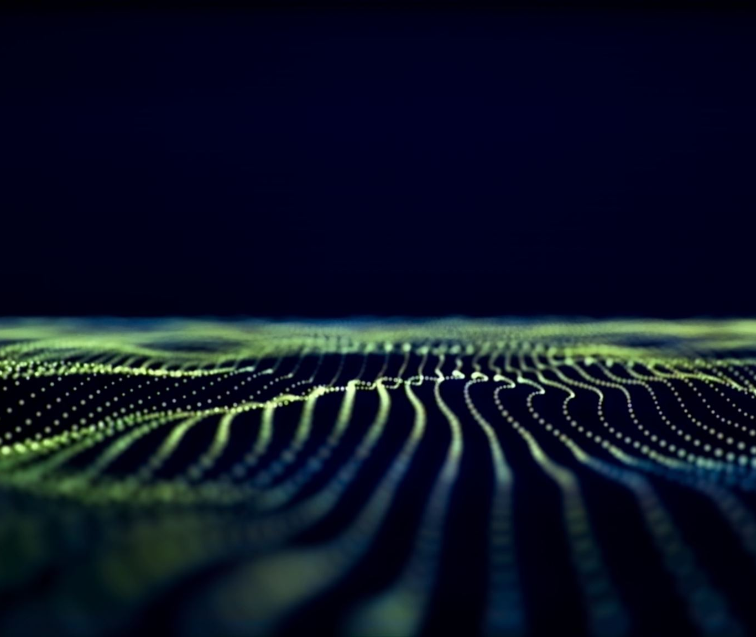
Race Classificationmodel

Slide 39
Modelling process
Race
The best base model
CNN (Convolutional Neural Network)
Output
Hyperparameter tuning
Base models
VGGFace
(Pre-trained)
ResNet
(Pre-trained)
39

Slide 40
Base models
Model | Train Accuracy | Test Accuracy
CNN | 0.3141 | 0.2262
VGGFace | 0.7993 | 0.8043
ResNet 50 | 0.3211 | 0.2895

Slide 41
Base models
VGGFace is the best!
Model | Train Accuracy | Test Accuracy
CNN | 0.3141 | 0.2262
VGGFace | 0.7993 | 0.8043
ResNet 50 | 0.3211 | 0.2895

Slide 42
Modelling process
Race
The best base model
CNN (Convolutional Neural Network)
Output
Hyperparameter tuning
Base models
VGGFace
(Pre-trained)
ResNet
(Pre-trained)
✅
42

Slide 43
Fine Tuning – VGG Face
Early stopping
Batch Normalization
Dropout
Model after fine-tuning

Slide 44
Model Comparison
Model | Train Accuracy | Test Accuracy
CNN | 0.3141 | 0.2262
VGGFace | 0.7993 | 0.8043
ResNet 50 | 0.3211 | 0.2895
VGGFace (tuned) | 0.8124 | 0.8379

Slide 45
Model Comparison
Model | Train Accuracy | Test Accuracy
CNN | 0.3141 | 0.2262
VGGFace | 0.7993 | 0.8043
ResNet 50 | 0.3211 | 0.2895
VGGFace (tuned) | 0.8124 | 0.8379

Slide 46
Other metrics – weighted average
Accuracy
0.84
Precision
0.83
Recall
0.84
F1 score
0.83

Slide 47
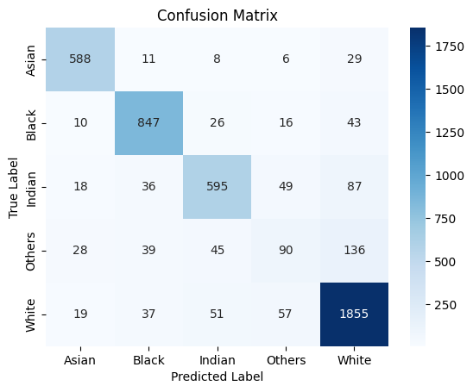
Confusion Matrix

Slide 48
Confusion Matrix
TP

Slide 49
Confusion Matrix
TP
FN

Slide 50
Confusion Matrix
TP
FN
FP

Slide 51
Confusion Matrix
TP
FN
FP
TN

Slide 52
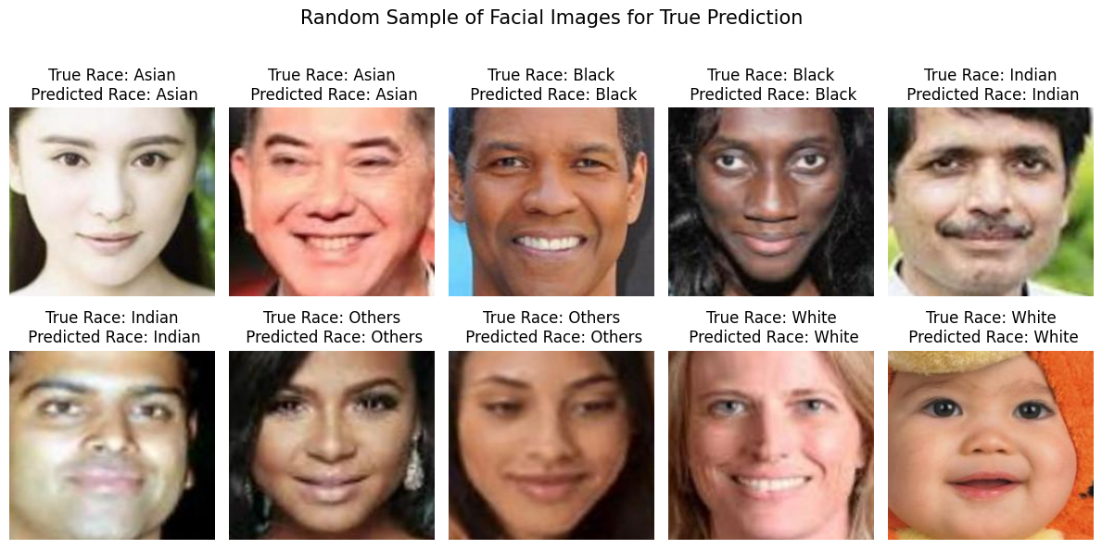
Samples of True Prediction

Slide 53
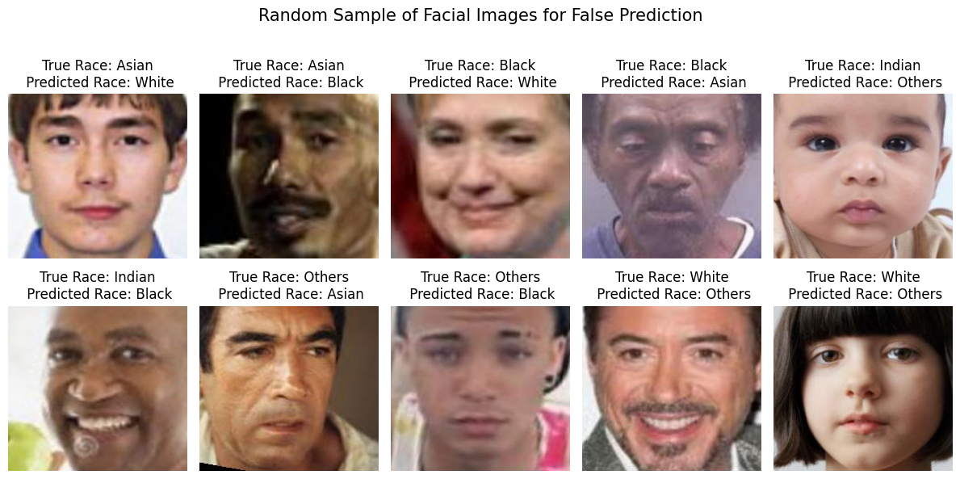
Samples of False Prediction

Slide 54
Machine learning models
Face Detection model
Gender classification model
Race classification model
Age classification model
54
Notes:
classification

Slide 55
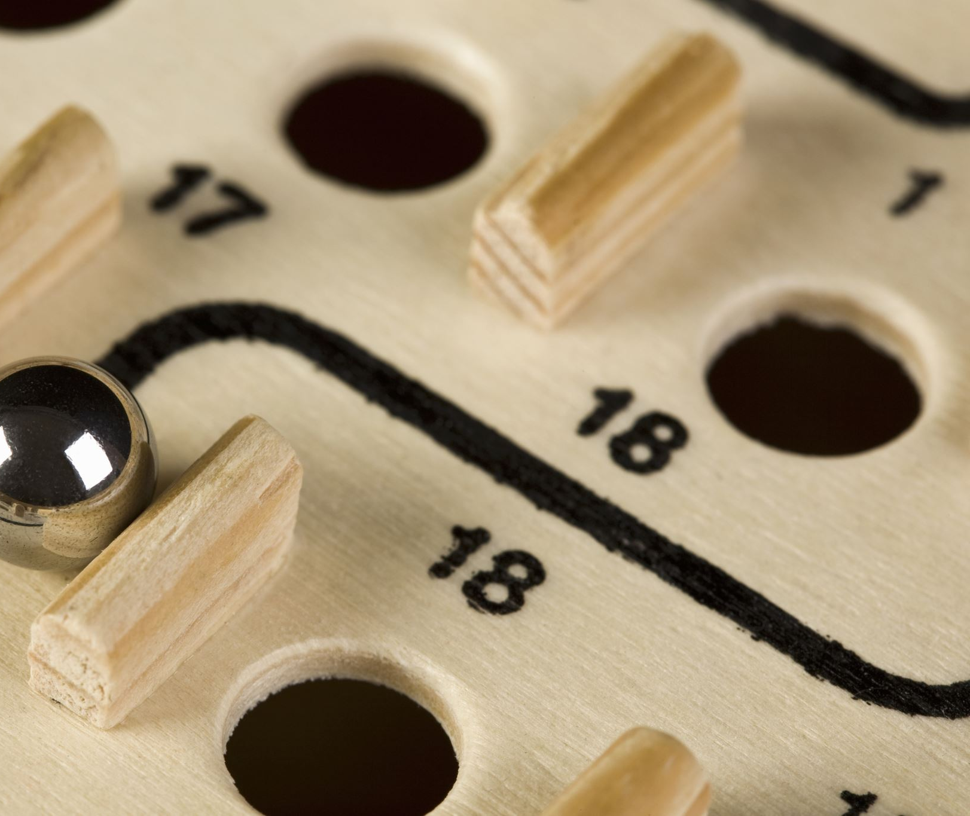
Age Classification model

Slide 56
Modelling process
Age
The best base model
CNN (Convolutional Neural Network)
Output
Hyperparameter tuning
Base models
VGGFace
(Pre-trained)
ResNet
(Pre-trained)
56

Slide 57
Base models
Model | Train Accuracy | Test Accuracy
CNN | 0.2793 | 0.3070
VGGFace | 0.5883 | 0.6096
ResNet 50 | 0.2476 | 0.6312

Slide 58
Base models
VGGFace is the best!
Model | Train Accuracy | Test Accuracy
CNN | 0.2793 | 0.3070
VGGFace | 0.5883 | 0.6096
ResNet 50 | 0.2476 | 0.6312

Slide 59
Modelling process
Age
The best base model
CNN (Convolutional Neural Network)
Output
Hyperparameter tuning
Base models
VGGFace
(Pre-trained)
ResNet
(Pre-trained)
✅
59

Slide 60
Fine Tuning – VGG Face
Early stopping
Batch Normalization
Dropout
Model after fine-tuning

Slide 61
Model Comparison
Model | Train Accuracy | Test Accuracy
CNN | 0.2793 | 0.3070
VGGFace | 0.5883 | 0.6096
ResNet 50 | 0.2476 | 0.6312
VGGFace (tuned) | 0.6128 | 0.6312

Slide 62
Model Comparison
Model | Train Accuracy | Test Accuracy
CNN | 0.2793 | 0.3070
VGGFace | 0.5883 | 0.6096
ResNet 50 | 0.2476 | 0.6312
VGGFace (tuned) | 0.6128 | 0.6312

Slide 63
Other metrics – weighted average
Accuracy
0.63
Precision
0.63
Recall
0.63
F1 score
0.62

Slide 64
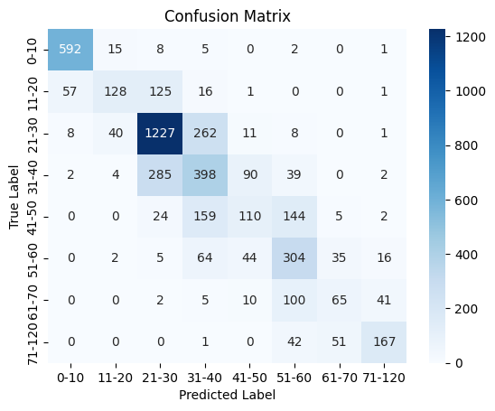
Confusion Matrix

Slide 65
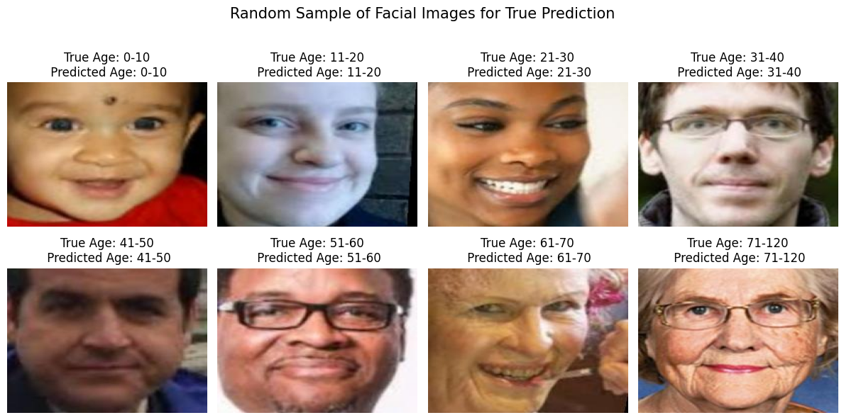
Samples of True Prediction

Slide 66
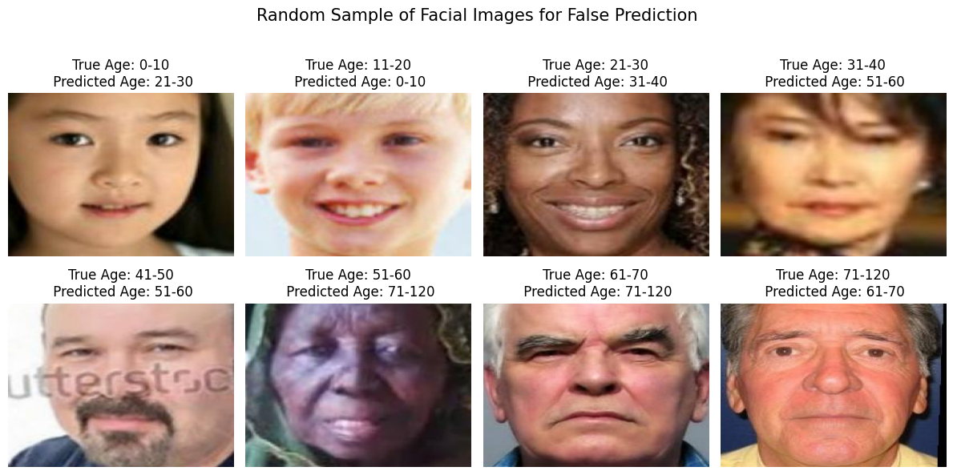
Samples of False Prediction

Slide 67
Machine learning models
Face Detection model
Gender classification model
Race classification model
Age classification model
67
Notes:
classification

Slide 68
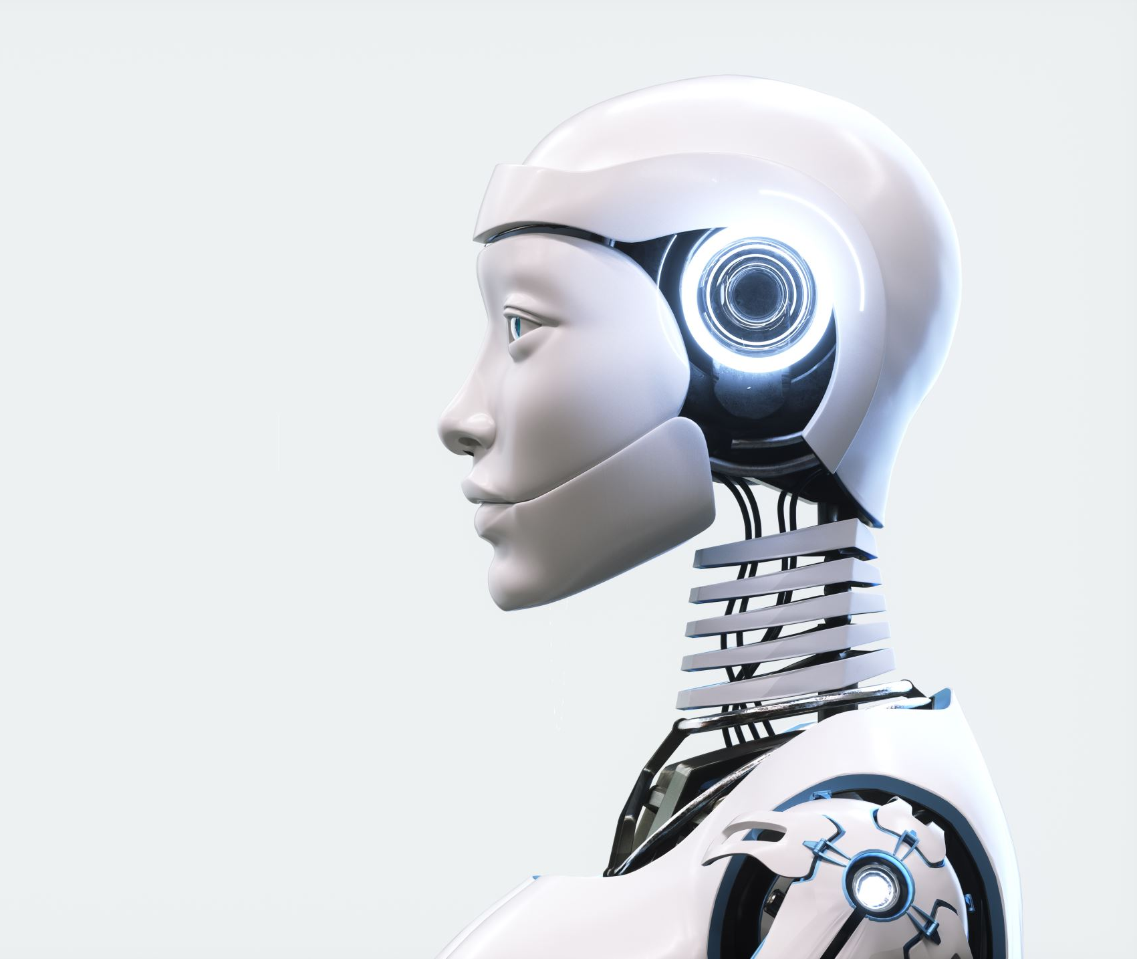
Face Detection Model

Slide 69
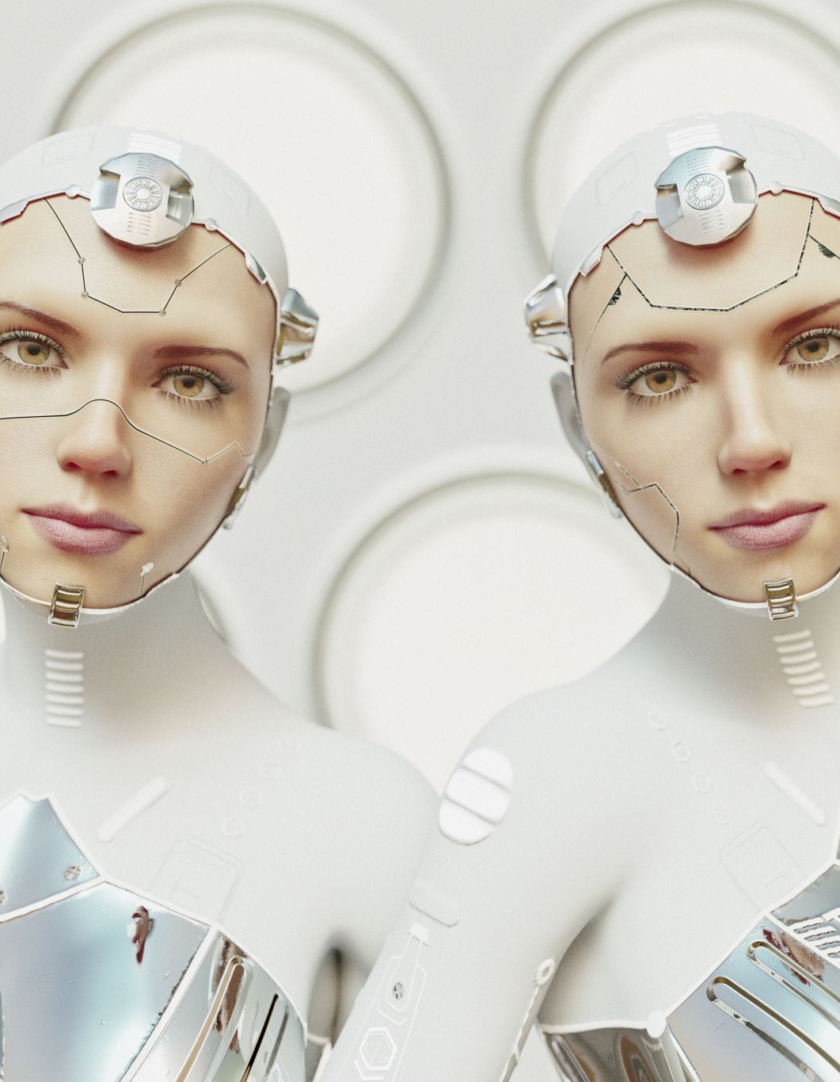
Face Detection model
MTCNN is a powerful tool for finding faces in images and videos. It's accurate, fast, and works well even in challenging conditions. This makes it a popular choice for tasks like facial recognition, image annotation, and emotion detection in videos.

Slide 70


Face Detection model
Faces
Gender
Age
Face Detection
Predictive model
Output
Race
Images or videos with labelled faces
Image or video

Slide 71
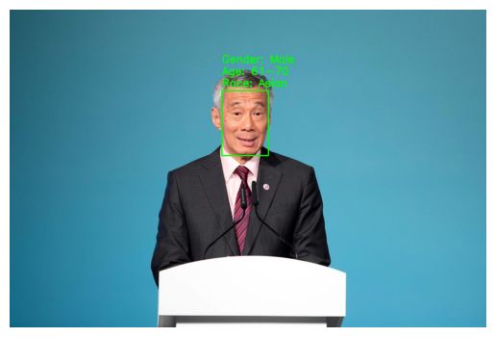
Face Detection on a single-face image

Slide 72
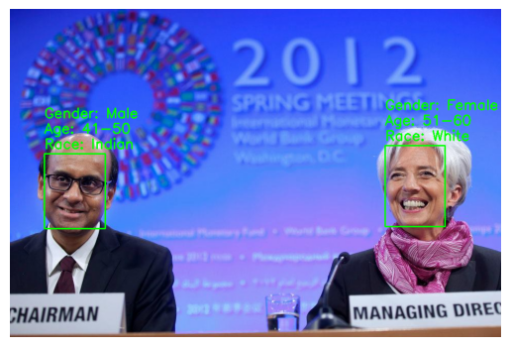
Face Detection on a multiple-faces image

Slide 73
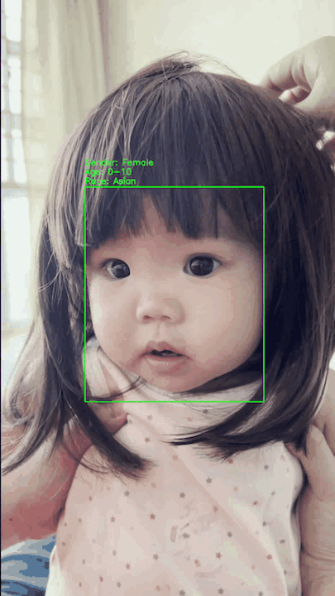
Face Detection on a single-face video

Slide 74
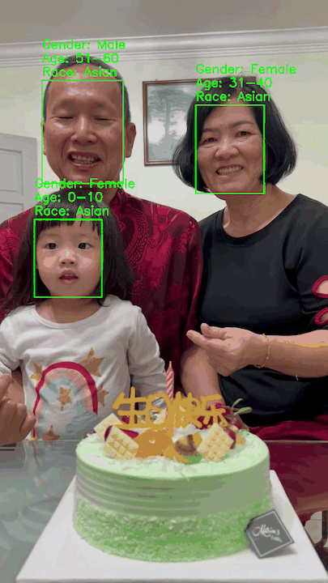
Face Detection on a multiple-faces video

Slide 75

Demo – Face detection on ATM customers

Slide 76
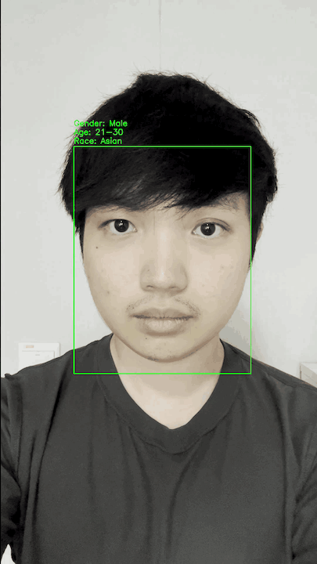
Video 1

Slide 77
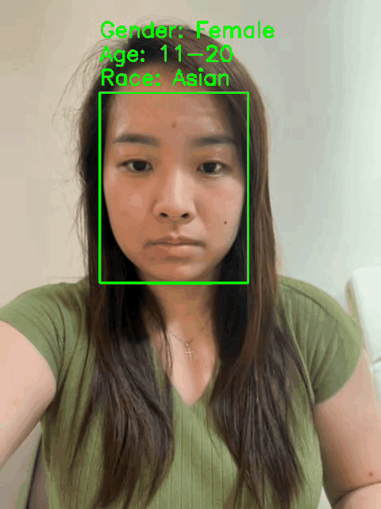
Video 2

Slide 78
Machine learning models
Face Detection model
Gender classification model
Race classification model
Age classification model
78
Notes:
classification

Slide 79

Cost and benefit analysis

Slide 80
Costs to be incurred
Development cost
Personnel costs for data scientists and engineers.
Implementation cost
Integration into existing ATM systems
Maintenance
Regular face model updates to ensure accuracy with new data.
Computational resources for training.
Costs of installing camera or any related hardware onto ATMs

Slide 81
Benefits to be realized:
Increased customer trust
Compliance with regulations
Prevention of financial loss

Slide 82

Live demo

Slide 83
Limitation of the models
Age model
The model has limited accuracy (0.6) when trying to determine age from facial features.
This is because judging age from appearance alone is difficult and subjective, as people can look much younger or older than their actual age.
👱🏻‍♂️👴🏻

Slide 84
Limitation of the models
Gender and Race model
Despite good performance in gender and race prediction, the model might be inaccurate due to limitations of facial features.
Just like age, appearance can vary significantly from a person's actual gender and race.
👨🏽👩🏻

Slide 85
Limitation of the models
Face Detection model
The model cannot detect faces with face masks on.
😷

Slide 86
What’s next?
Appearance age
Due to the difference between appearance and actual demographics, banks might need to store additional data about a customer's perceived appearance.
In cases like a 30-year-old customer consistently appearing like a 20-year-old, the system should adapt to recognize their "appearance age".
This solves the problem of profiles mismatching a customer's visual presentation.
Banks may consider mandatory mask removal for cash withdrawals at ATMs.
💡

Slide 87
Conclusion
The models effectively tackle the problem statement by enhancing ATM security.
The models improve ATM security by using face detection to flag suspicious withdrawals where the person doesn't match the cardholder. This builds customer trust in the bank's ATMs.
🥰🏦

Slide 88

Q&A

Slide 89

Thank you!

